Slide 1
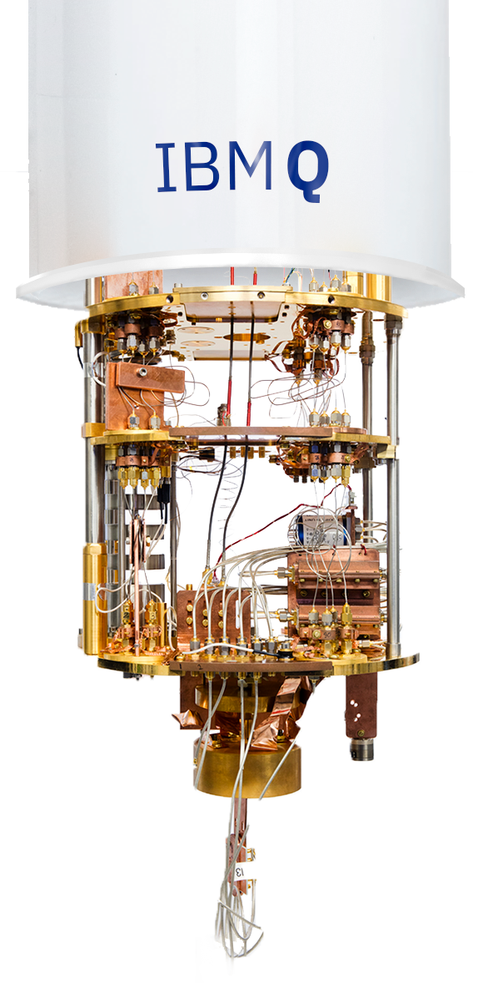
Quantum Computing
|Ψ⟩

Slide 2
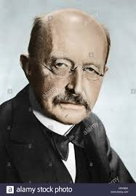
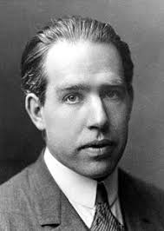
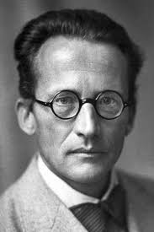
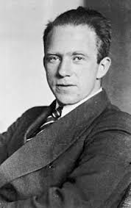
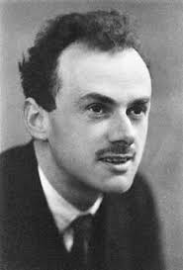
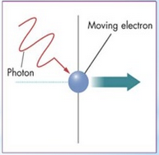
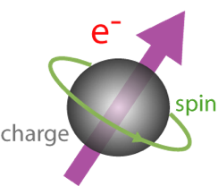

Discovery of Quantum Phenomena (1900 – 1930)
Quantum
Wave-particle duality
Uncertainty principle
Superposition
Measurements
Entanglement
Planck
Bohr
Schrödinger
Heisenberg
Dirac
Light Polarization
Electron spin
Measurement
problem
Notes:
Correlation travels faster than light, but correlation itself is useless. We still need classical communication to be able to qualify the states
Entanglement is natural:
electron shell of atoms always consists of entangled electrons
molecule’s lowest energy state, in which it is most usually found, is a highly entangled state of its electrons and nuclei
photosynthesis , as the mechanism for converting optical energy to kinetic and then chemical energy
Protein in the migratory birds eyes have nuclear spins that get entangled with electrons under influence of the earth's magnetic field and this helps the birds orientate durng their flight
Speculated entanglement between bacteria and quantized light

Slide 3
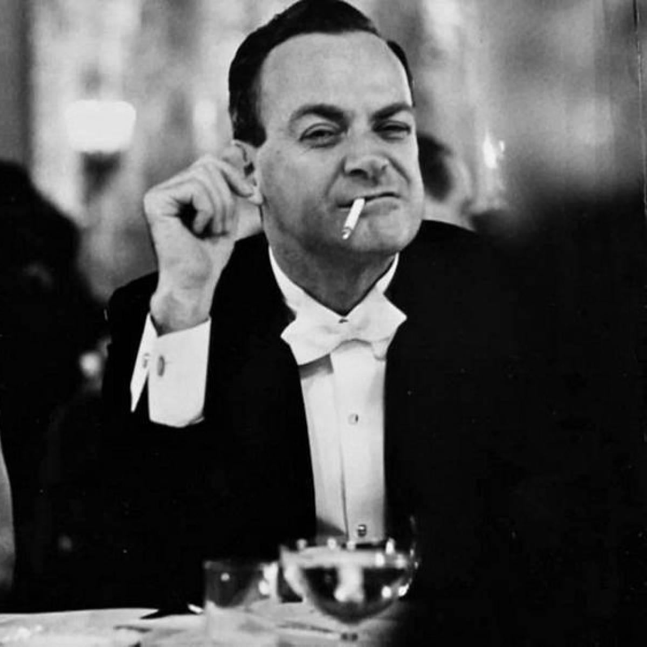
Quantum Information Theory (1970 – 1990)
Youri Manin
Richard Feynmann
“To simulate quantum systems
we would need to build a quantum computer”

Slide 4
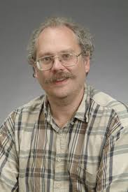
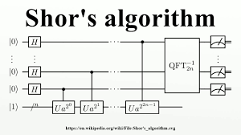

Quantum Algorithms (1990 – today)
Deutsch’s Algorithm (1992)
Peter Schor’s Algorithm (1994)
Grover’s Algorithm (1996)
15 = 3 x 5
38647884621009387621432325631 = ? x ?

Slide 5
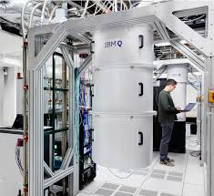
First Quantum Computers (1997 – 2015)
NMR Qubit – 1997
Oxford
Berkeley
IBM Almaden
Superconducting Qubit – 1999
IBM quantum in 2002
IBM Q Experience in 2015
IBM and Google quantum computers with 53 qubits in 2019

Slide 6
2nd Quantum Revolution (2019 – )

Slide 7
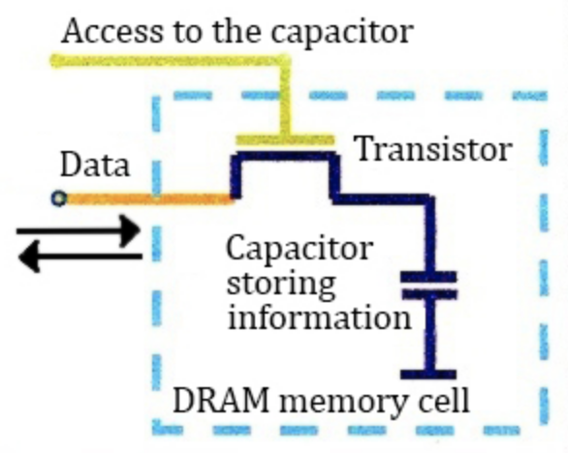
Classical Information
Physically, it is implemented in a capacitor of the memory chip
Logically, bit is a unit of information and has two possible states: 0 and 1.
If the capacitor is full of electrons, it represents
the bit value of 1. If it is empty, it represents 0.
Computers rely on the behavior of electrons, but
don’t use superposition state to represent the information

Slide 8
Quantum bit (Qubit)
Physically, a qubit can be implemented in various ways (we’ll see them later).
Logically, qubit is a unit of information, but is not limited to only two possible states.
It is determined by function:
|Ψ⟩ = α|0⟩ + β|1⟩, where |α|² + |β|² = 1 and α and β are complex numbers
This can be represented by:
, where 0 ≤ θ ≤ π, 0 ≤ φ ≤ 2π
|0⟩ = |1⟩ =
Notes:
When we measure it, it is always 0 or 1. Before measurement, it can be in one of the basis states, but it can also be in the superposition state

Slide 9
Quantum Information
1 qubit can represent simultaneously 2 bits
2 qubits can represent 4 bits or 2^2
10 qubits can represent 2^10 bits or 128 bytes
30 qubits can represent 2^30 bits or 128 MB
40 qubits can represent 2^40 bits or 128 GB
50 qubits can represent 2^50 bits or 128 TB
…
Multi-level quantum systems or qudits (d-level) can represent d^n bits
The big idea here is to use superposition state and encode much more information in qubits than it is possible in bits
But, loading data in the quantum state will take long

Slide 10
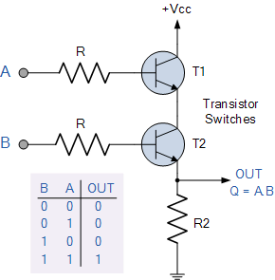
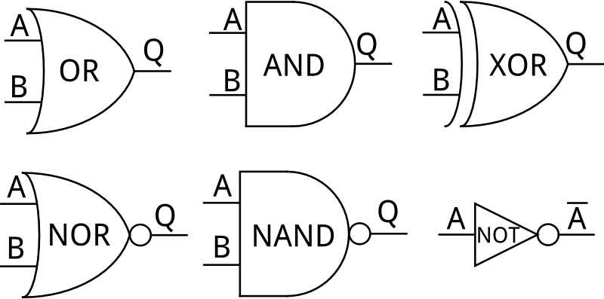
Classical Gates
… which are implemented with transistors
Computation circuit is made of logical gates
Source:https://www.electronics-tutorials.ws/logic/logic_2.html

Slide 11
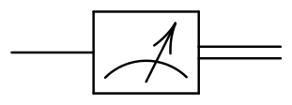
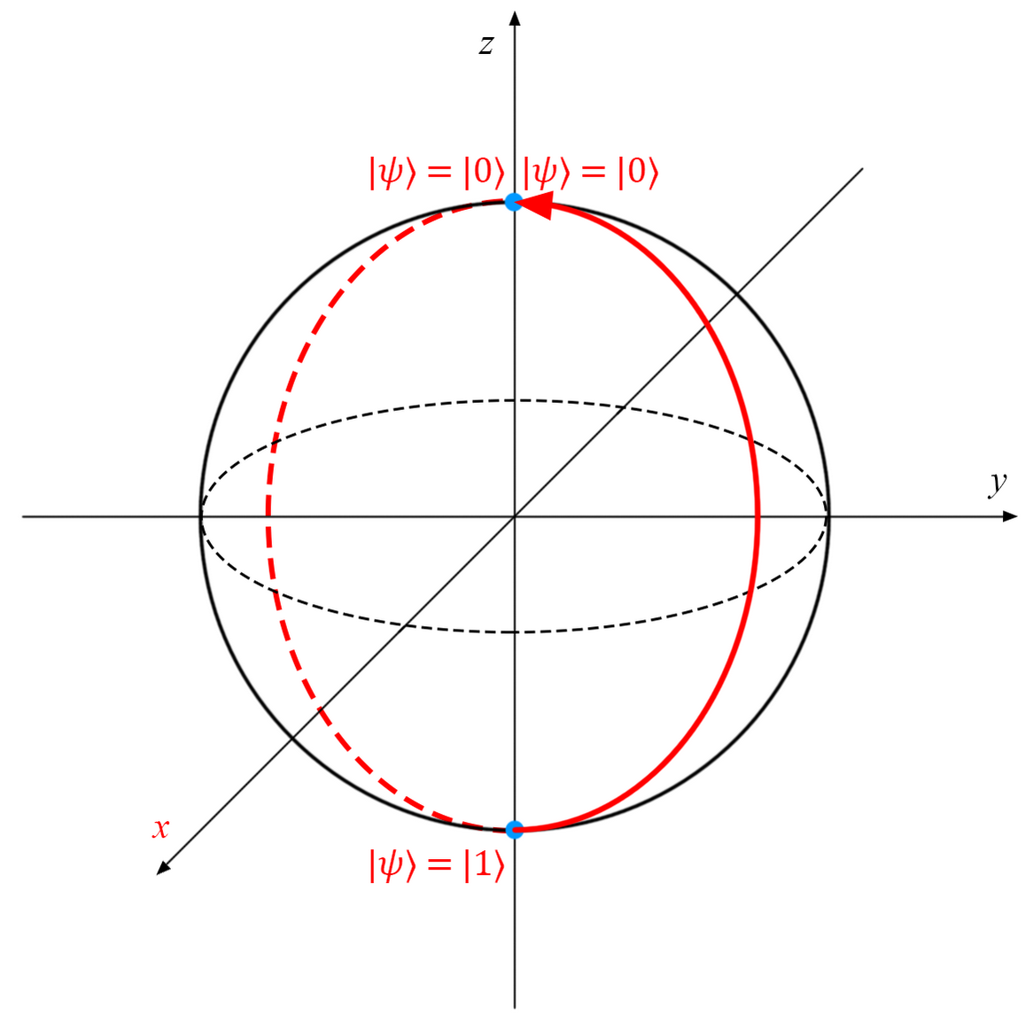
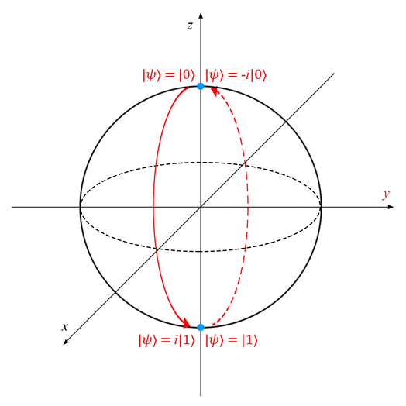
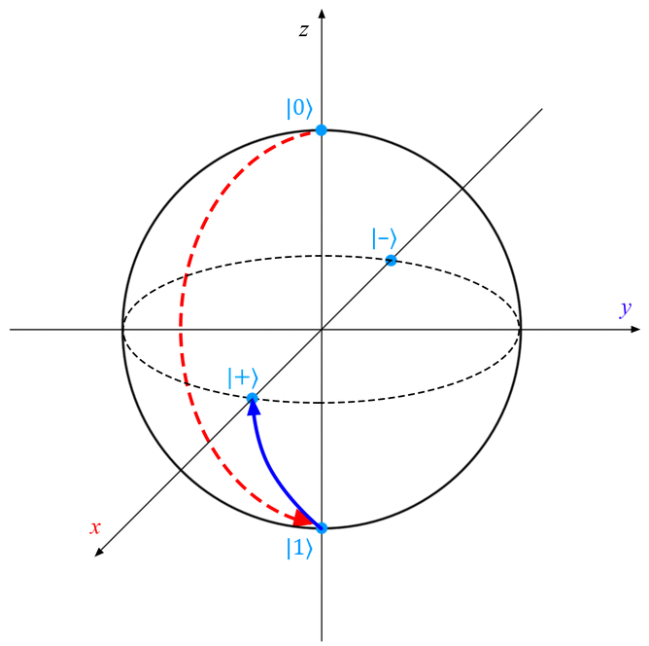
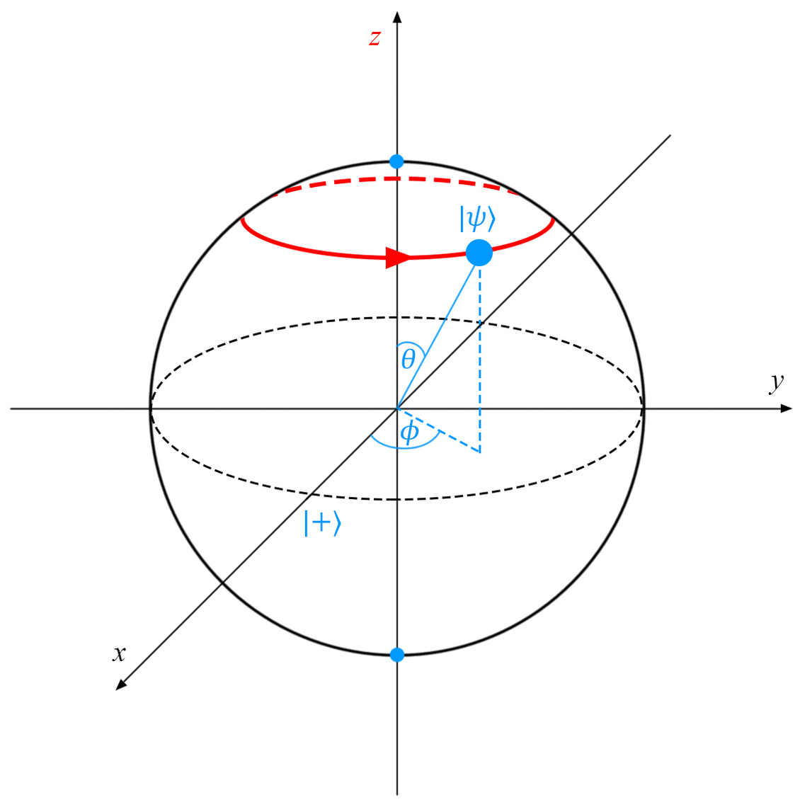
Quantum Gates
superposition
entanglement
X or bit-flip
Z or phase-flip
Y
Hadamard
CNOT
Toffoli
SWAP
Measurement
X
Z
Y
H
Input | Output
Q1:|0⟩ | |1⟩
Q1:|1⟩ | |0⟩
Input | Output
Q1:|0⟩ | |1⟩
Q1:|1⟩ | -|1⟩
Input | Output
Q1:|0⟩ | i|1⟩
Q1:|1⟩ | -i|0⟩
Input | Output
Q1:|0⟩ | |+⟩ , or : 1/√2 (|0⟩+|1⟩)
Q1:|1⟩ | |-⟩, or : 1/√2 (|0⟩-|1⟩)
Input | Output
Q1:|0⟩ Q2:|0⟩ | Q1:|0⟩ Q2:|0⟩
Q1:|0⟩ Q2:|1⟩ | Q1:|0⟩ Q2:|1⟩
Q1:|1⟩ Q2:|0⟩ | Q1:|1⟩ Q2:|1⟩
Q1:|1⟩ Q2:|1⟩ | Q1:|1⟩ Q2:|0⟩
Input | Output
Q1:|0⟩ Q2:|0⟩ Q3:|0⟩ | Q1:|0⟩ Q2:|0⟩ Q2:|0⟩
Q1:|0⟩ Q2:|0⟩ Q2:|1⟩ | Q1:|0⟩ Q2:|0⟩ Q2:|1⟩
Q1:|0⟩ Q2:|1⟩ Q2:|0⟩ | Q1:|0⟩ Q2:|1⟩ Q2:|0⟩
Q1:|0⟩ Q2:|1⟩ Q2:|1⟩ | Q1:|0⟩ Q2:|1⟩ Q2:|1⟩
Q1:|1⟩ Q2:|0⟩ Q2:|0⟩ | Q1:|1⟩ Q2:|0⟩ Q2:|0⟩
Q1:|1⟩ Q2:|0⟩ Q2:|1⟩ | Q1:|1⟩ Q2:|0⟩ Q2:|1⟩
Q1:|1⟩ Q2:|1⟩ Q2:|0⟩ | Q1:|1⟩ Q2:|1⟩ Q2:|1⟩
Q1:|1⟩ Q2:|1⟩ Q2:|1⟩ | Q1:|1⟩ Q2:|1⟩ Q2:|0⟩
Input | Output
Q1:|0⟩ Q2:|1⟩ | Q1:|1⟩ Q2:|0⟩
Q1:|1⟩ Q2:|0⟩ | Q1:|0⟩ Q2:|1⟩
Rotation around x
Rotation around y
Rotation around z
Rotation around x + z
Notes:
The big idea here is to use entanglement to parallelize the operations on all qubits simultaneously, and then the constructive and destructive interference to obtain the correct results of the computation

Slide 12
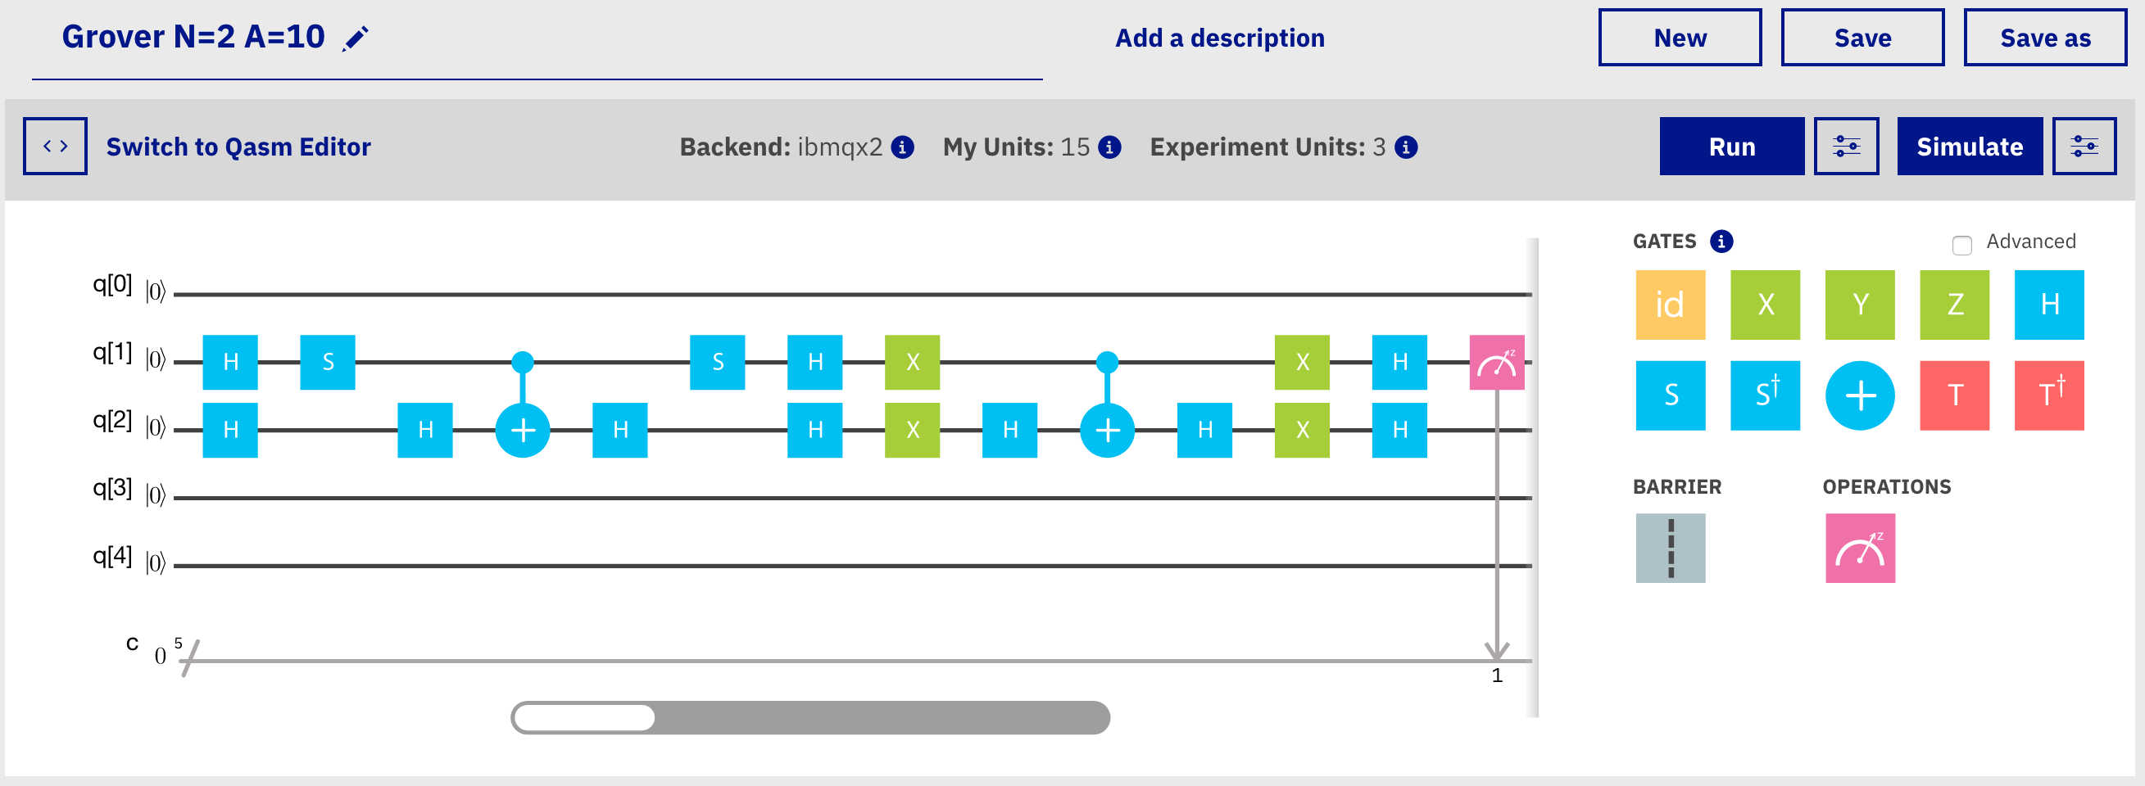
Quantum Circuit
IBM Quantum Composer (GUI)
QASM (low level programming)
Qiskit (Python libraries)
Other, recent toolkits:
Q#, Cirq, Forest, StrawberryFields, QuTIP

Slide 13
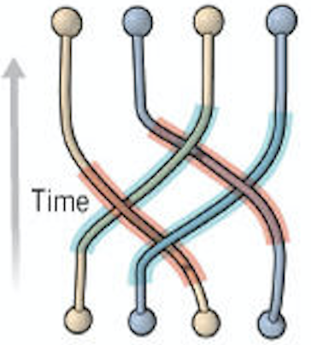
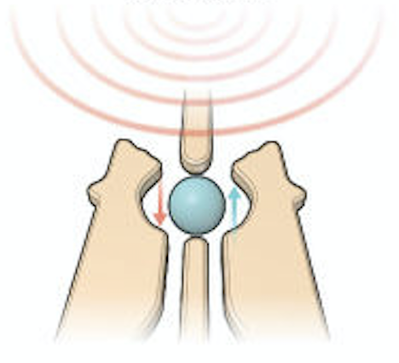
Quantum Computing Technologies
Topological (Microsoft)
Ion traps (IonQ)
Quantum dots (Intel)
Longevity (>20m), high fidelity,
but slow operations
Very stable, no need for error correction, but still a research project
Easy to build and scale,
but difficult to control, decoherence
Notes:
State of the art : superconducting

Slide 14
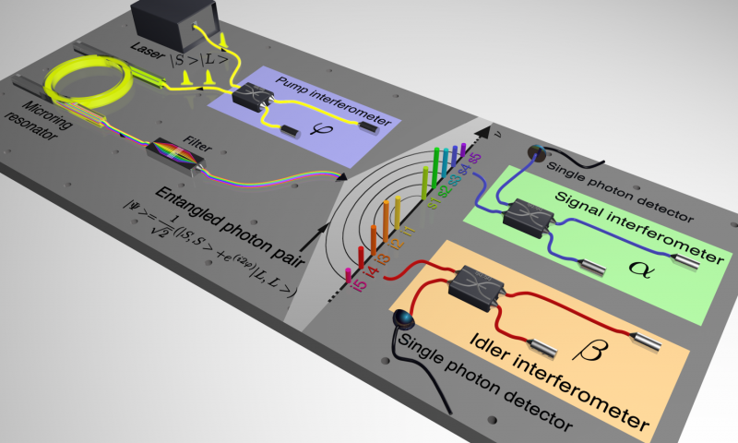
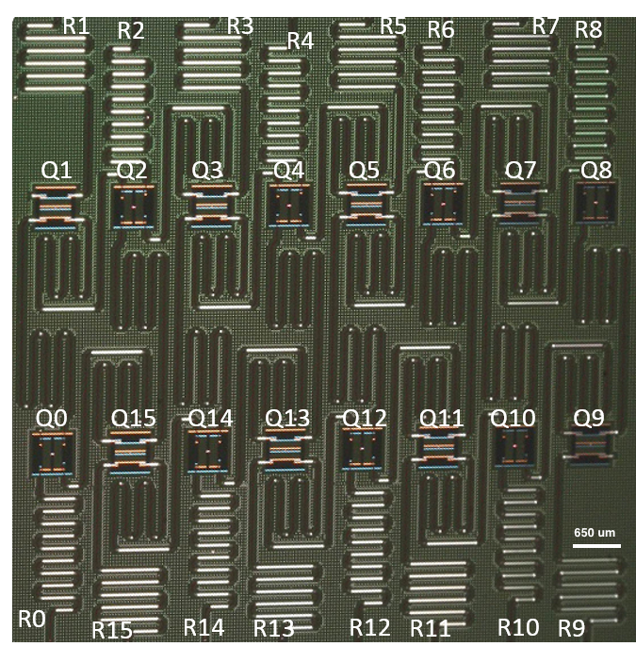
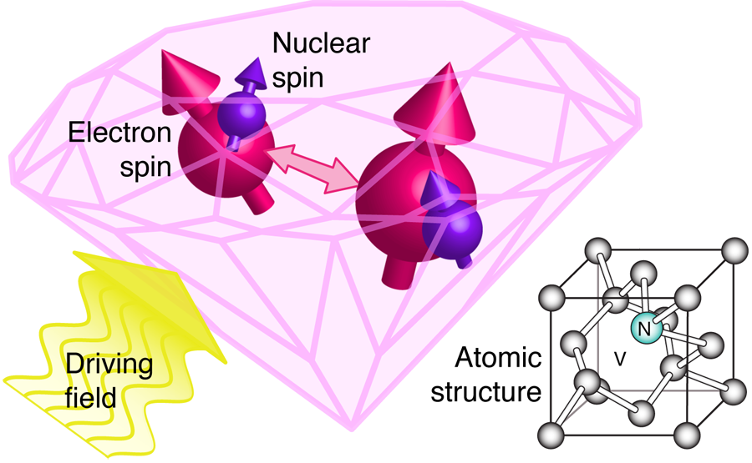
Quantum Computing Technologies
Photonic*) (various groups)
Transmon (IBM, Google, Rigetti)
NV Diamond Qubit
Photons are very flexible, but difficult to interact
Photons can be used to transfer the information and interconnect the diamonds in a network, but problem is to accurately place the defects
*) See also: Continuous variable quantum computation
Notes:
State of the art : superconducting.
Superconducting circuit as macroscopic quantum system

Slide 15
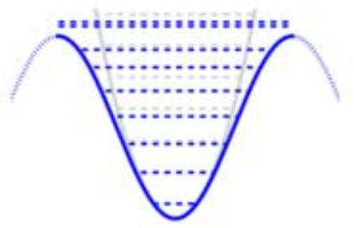
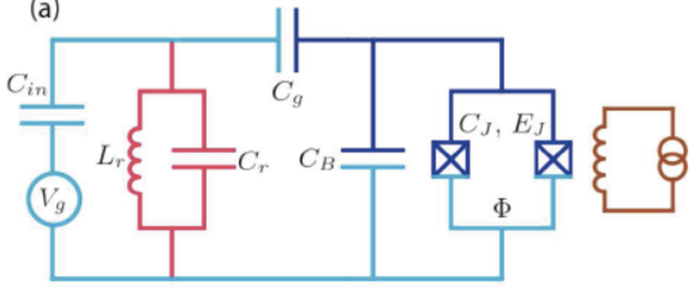

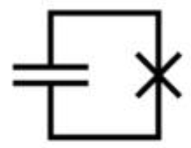

Superconducting Qubits
Josephson junctions
Transmon
E₁ or |1⟩
Microwave pulses
E₀ or |0⟩
Tuning circuit
Coupling capacitance
Cooper pair box
Readout resonator
Anharmonic oscillator
π/2 pulse
Circuit needs to be cooled to near absolute zero
This makes all electrons create a collective quantum state
Energy oscillates between the capacitor and JJ anharmonically
No resistance, only the circuit resonance
Microwave pulses act on this resonance to change the state
Readout is done by getting and amplifying the resonator’s signals Entanglement is performed by driving one qubit at the frequency of the second qubit
Josephson Junction
(equivalent to transistor)
−π/2 pulse
Circuit
Rotation gates are implemented
with microwave pulses :
Pulse phase 0 for X rotation
Pulse phase π/2 for Y rotation
Z + Y for Z rotation
Pulse duration determines the angle
Notes:
Charge – based superconducting qubit

Slide 16
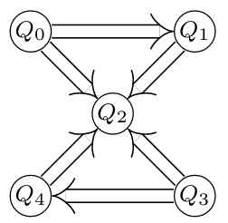
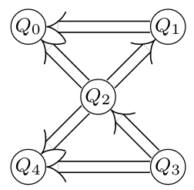
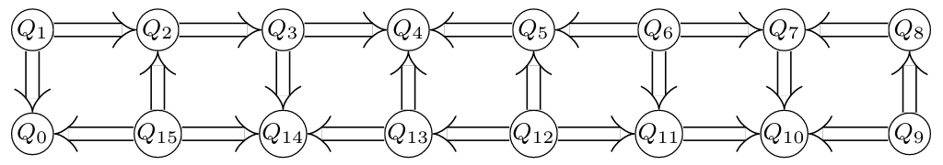
Understanding IBM QX Architecture
Quantum Processing Units (QPU) with 5, 16, 20 and 53 qubits
CNOT two-qubit gates are possible between qubits with resonator connection
Necessary to map the higher-level gates (Toffoli, SWAP) into supported elementary operations
IBM QX2
IBM QX4
IBM Rochester
IBM QX5

Slide 17
Some well-known quantum algorithms
Schor’s algorithm for prime factorization
Grover’s algorithm for database search
Constraint satisfaction problems (3-SAT)
Quantum algorithm for linear systems of equations (HHL)
Quantum algorithm for SVM
Quantum Approximation Optimization Algorithm (QAOA)
Variational Quantum Eigensolver (VQE)

Slide 18
Use cases
Search of unstructured data
Factoring large numbers and cryptography
Quantum chemistry
Machine learning
Optimization problems
Generating random numbers
Risk modeling
Quantum networking
Recommender system
Notes:
But not suitable for problems requiring big data. This is more a case for HPC that can read petabytes of data as they process them. Used for weather simulations, airplane design and similar

Slide 19
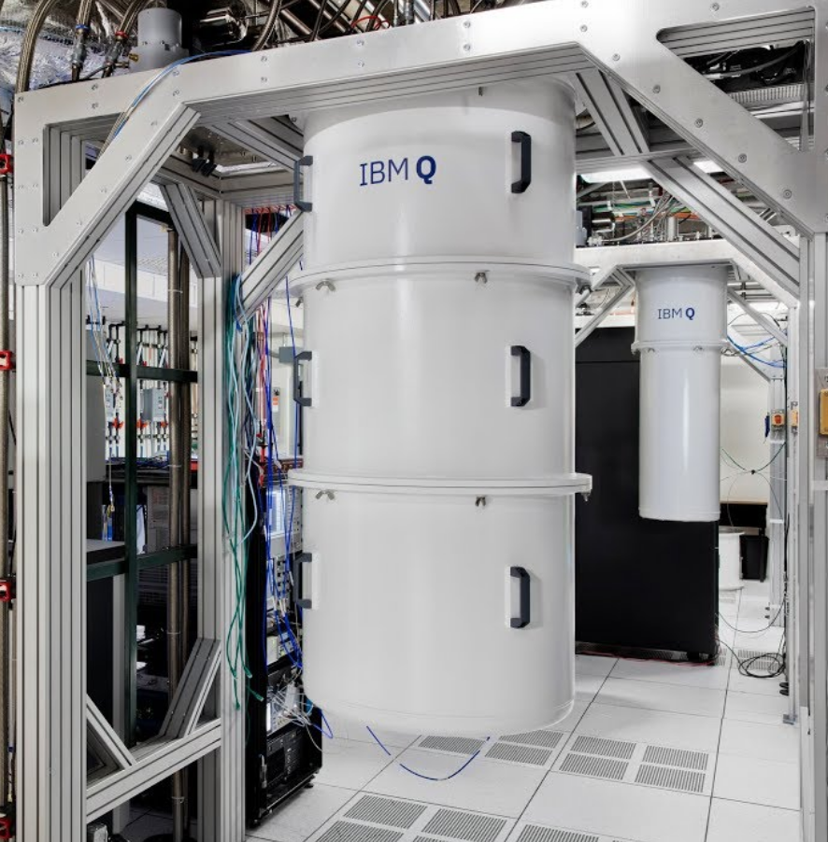
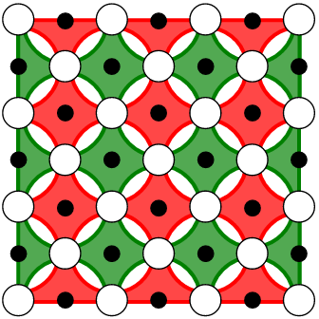
Building large-scale quantum computer
Challenges :
Storing to and accessing the memory
Development of high-fidelity operations in a scalable architecture
Increase coherence time from current 70 µs
Scalability
Developing algorithms
Quantum Error Correction -
3 qubits for bit flip errors
X 3 for phase flip errors
X 2 for the measurement errors
= 18 physical qubits for one logical
But for the target accuracy of 100%,
the overhead will be X 10’000
 | t | fidelity
1-q gate | 15 ns | 99.8%
2-q gate | 200 ns | 99%
T1 | >100µs
T2 | 30 µs
Notes:
Current fidelity of 1-q gate operations on superconducting qubit is 99.8%, 2-q gate operation is 99%
For Shor’s algorithm to factor 1024-bit numbers, we need in total 5-6000 high quality logical qubits
Goal of QEC is to Preserve the state of the logical qubit even if the errors occur
Various schemas, for surface code, it requires 4 physical for one logical

